Slide 1
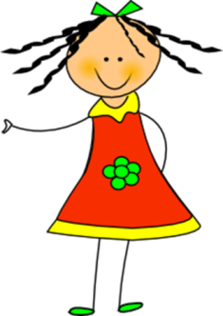
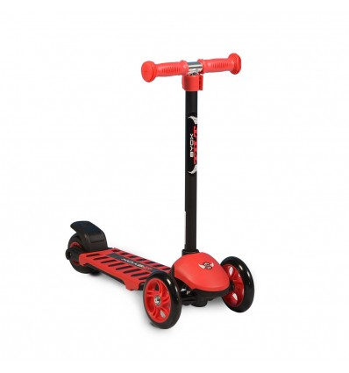
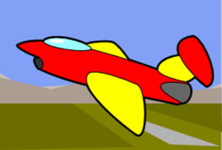
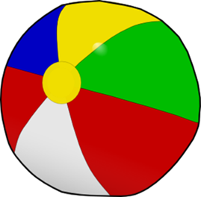
Many, many toys!

Slide 2
Listen, point and say

Slide 3
Let’s play a guessing game!

Slide 8
Make a question
Is it a …….. ?

Slide 10
Make a question
Is it a …….. ?

Slide 12
Let’s play!
Click on the link below:
http://www.quia.com/jg/3114018.html

Slide 13
Listen to the chant!
This is my doll.
This is my doll.
It’s big and tall!
This is my car.
This is my car.
It’s red and black!

Slide 14
Let’s say the chant
together!

Slide 15
Let’s say the chant!
This is my doll.
This is my doll.
It’s big and tall!
This is my car.
This is my car.
It’s red and black!

Slide 16
Let’s sing 10 little aeroplanes!
Click here:
https://youtu.be/4J5ywWdp_-M

Slide 17
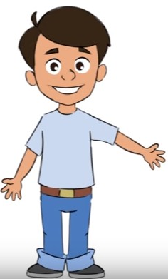
This is my poster. Listen!
Now, make your own poster!

Slide 18
Images courtesy of:
http://www.clker.com
clipart-library.com
Presentation designed by the English Curriculum Development team,
Cyprus Ministry of Education, Culture, Sports and Youth.

