Slide 1
Unit 3 Food and drinks
I like …/ I don’t like …

Slide 2
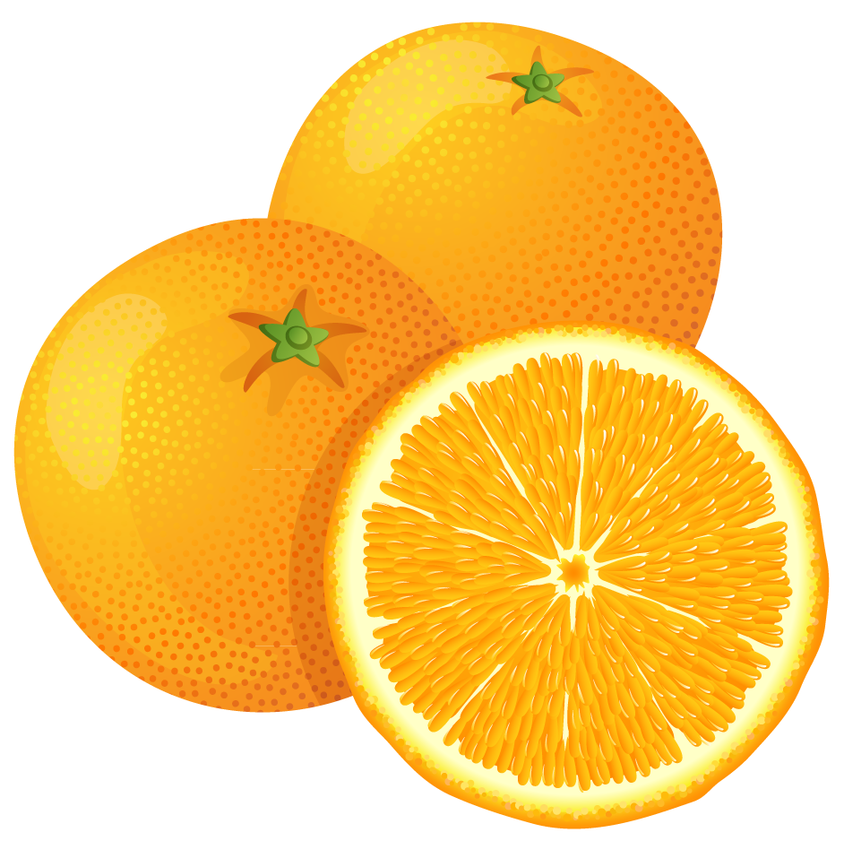
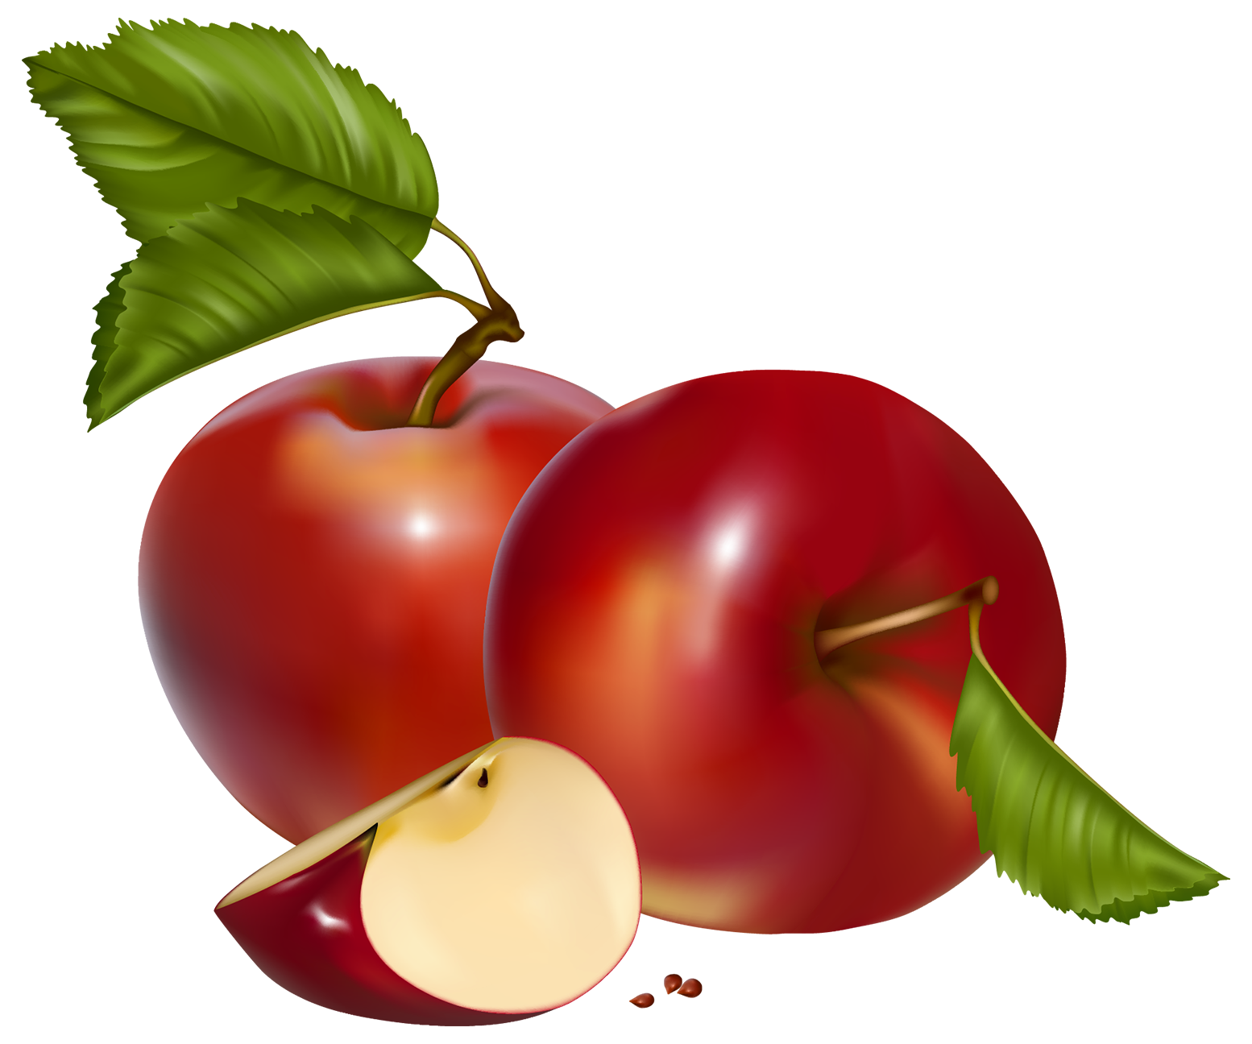
Practise what we already know
Click on the hidden image and say the correct word!
apples, bananas, oranges, pears
4
3
1
2

Slide 3
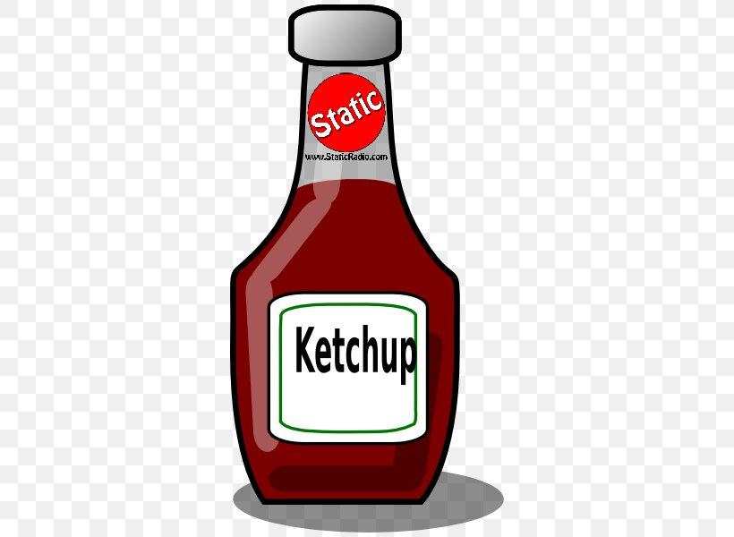
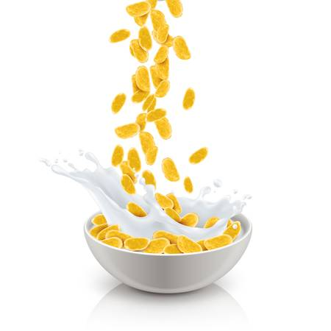
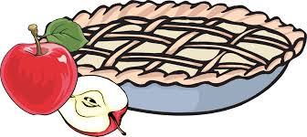
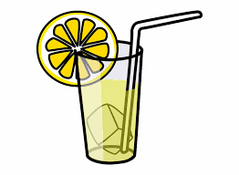
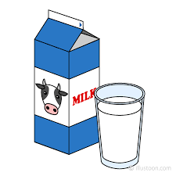
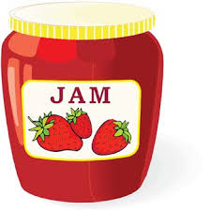
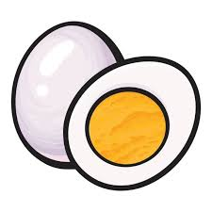
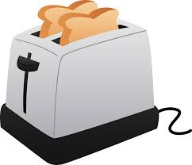
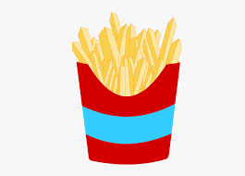
New food vocabulary
Listen and repeat the words silently, loudly, quickly, happily!
ketchup, corn flakes, apple pie, lemonade, egg, toast, chips, jam, milk

Slide 4
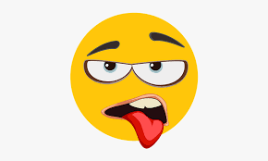
Listen to the jazz chant and repeat
I like I don’t like
I like corn flakes, I like milk
Apple pie? Yes, yes, please!
I don’t like lemonade, I don’t like eggs. Ketchup and jam? Yuck! No, thanks!

Slide 5
Memory game: Every time you find a match say I like… or I don’t like … e.g. When you find toast: I like toast! When you find eggs: I don’t like eggs.

Slide 6
Watch the following video:
Book title: Ketchup on your cornflakes by Nick Sharratt

Slide 7
Answer the questions

Slide 8
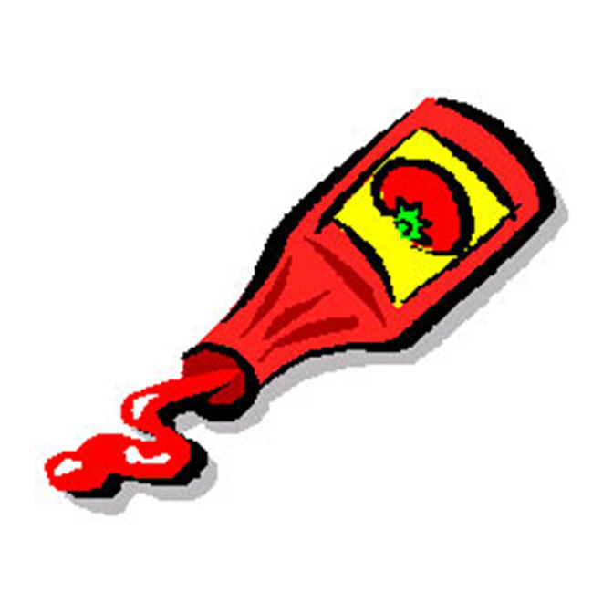
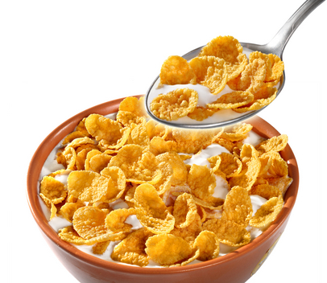
Do you like
ketchup
on your
cornflakes?

Slide 9
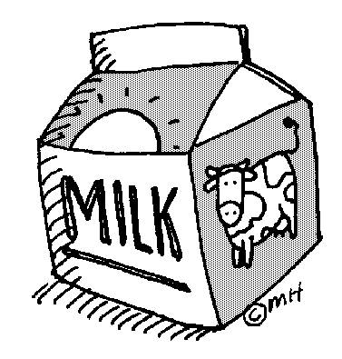
Do you like
milk
on your
cornflakes?

Slide 10
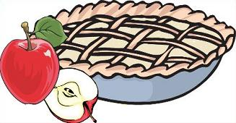
Do you like
ice cubes
on your
apple pie?

Slide 11
Do you like
ice cubes
in your
lemonade?

Slide 12
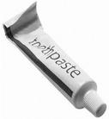
Do you like
toothpaste
in your
lemonade?

Slide 13
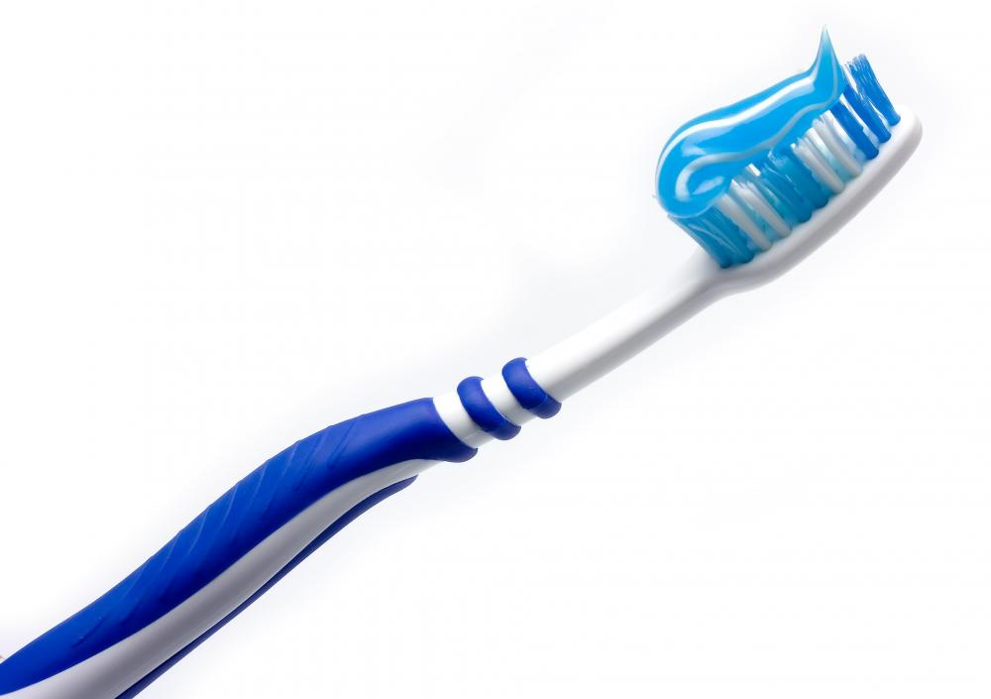
Do you like
toothpaste
on your
toothbrush?

Slide 14
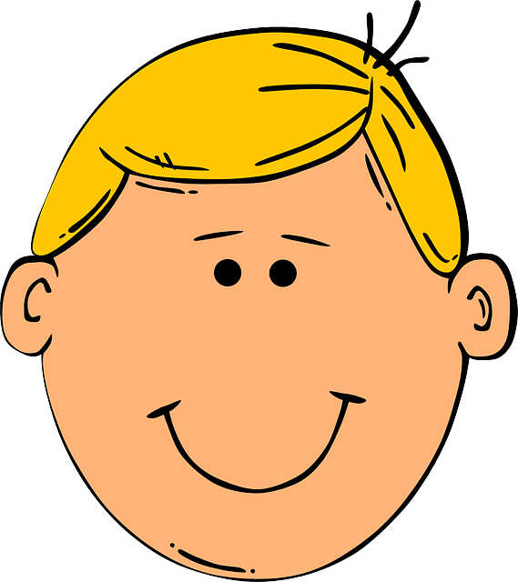
Do you like
toothpaste
on your
head?

Slide 15
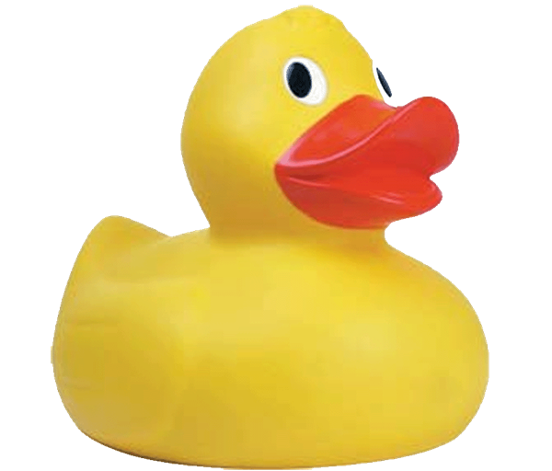
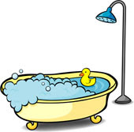
Do you like
a duck
in your
bath?

Slide 16
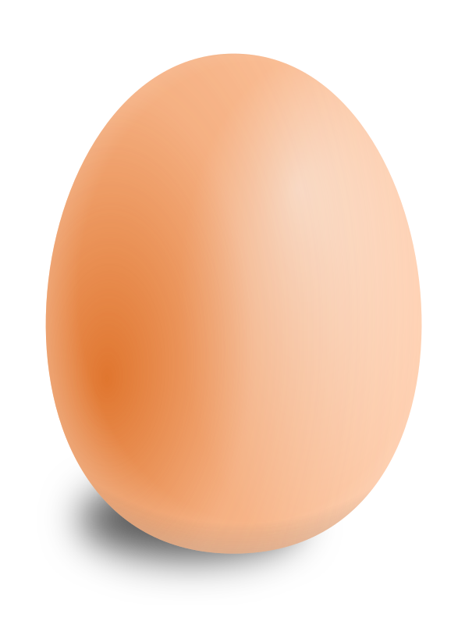
Do you like
a duck
on your
egg?

Slide 17
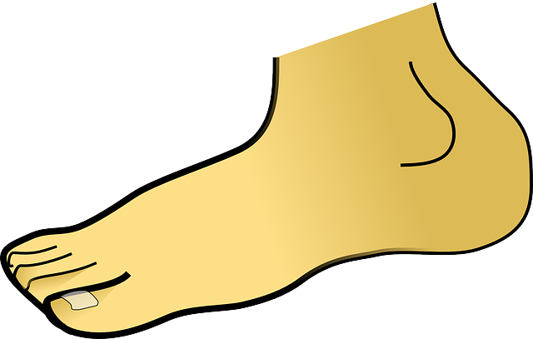
Do you like
a duck
on your
toes?

Slide 18
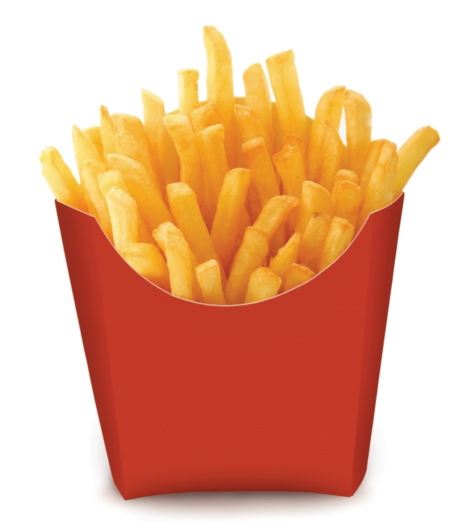
Do you like
salt
on your
chips?

Slide 19
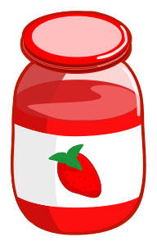
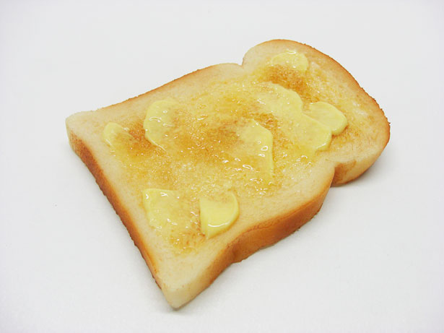
Do you like
jam
on your
toast?

Slide 20
Do you like
a teddy
on your
chips?

Slide 21
Do you like
milk
on your
corn flakes?

Slide 22
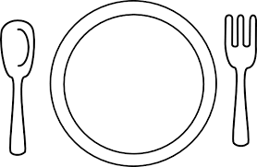
Draw a funny breakfast!

