Slide 1
numbers
Year 3

Slide 2
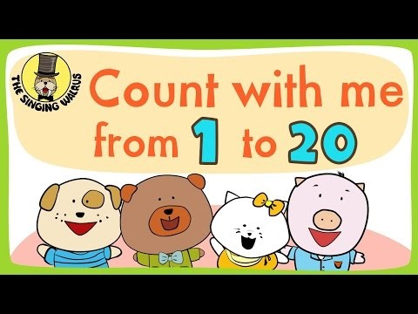
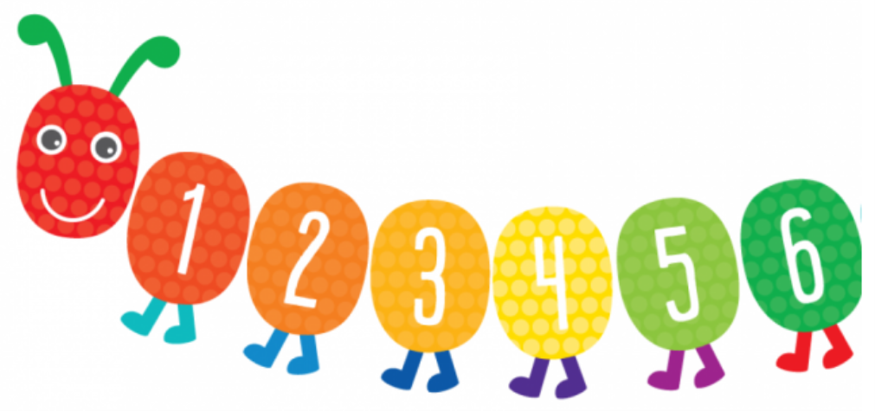
Let’s sing
a song!

Slide 3
Try this game ! Listen and choose the right number!
https://www.agendaweb.org/exercises/vocabulary/audio/numbers-1

Slide 4

Try these too! Match the numbers with the words!
https://www.quia.com/mc/3109874.html
https://learnenglishkids.britishcouncil.org/word-games/numbers-11-20

Slide 5
Let’s play and
check your memory!
https://www.helpfulgames.com/subjects/english/281-numbers-from-1-to-20.html

Slide 6

Now, let’s write the numbers 1-20 with words!
http://www.adelescorner.org/vocab/numbers2/numbers2.html

Slide 7

How old is emma?
eleven
twelve

Slide 8


Slide 9


Slide 10

How old is Jason?
twenty
twelve

Slide 11



Slide 12



Slide 13
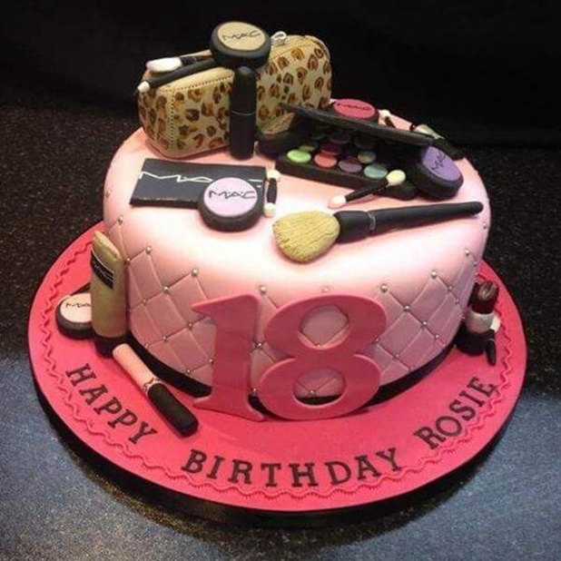
How old is Rosie?
eight
eighteen

Slide 16
Useful links
https://agendaweb.org/exercises/vocabulary/numbers/numbers-20
https://agendaweb.org/exercises/vocabulary/numbers/10-20
http://s.mound.free.fr/skyblues67/numbers/numssnd/xworddict20.htm

Slide 17
Images courtesy of:
https://www.brightstarkids.com.au/counting-caterpillar-wall-sticker.html
https://thebirthdaybest.com/happy-birthday-wishes/
https://www.funimada.com/birthday-cards/age-specific/20th-birthday.html
https://twitter.com/tftsheffield/status/496646853845585920
https://wikiclipart.com/thumbs-up-clipart_5083/
http://clipart-library.com/clipart/1293729.htm
Presentation designed by the English Curriculum Development team,
Cyprus Ministry of Education and Culture

