Slide 1
Alphabet – Click on the correct picture
Year 2

Slide 2
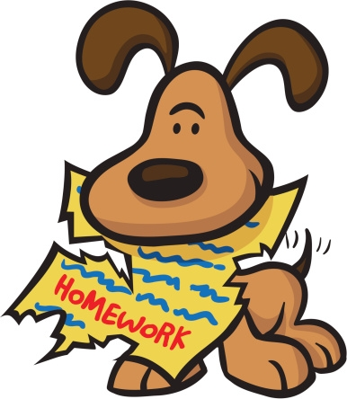
Big B, little b!
What begins with Bb?
Click on the right picture!

Slide 5
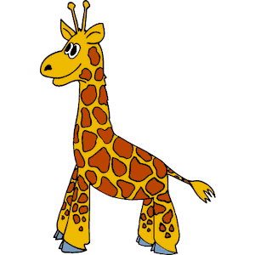
Big G, little g!
What begins with Gg?
Click on the right picture!

Slide 8
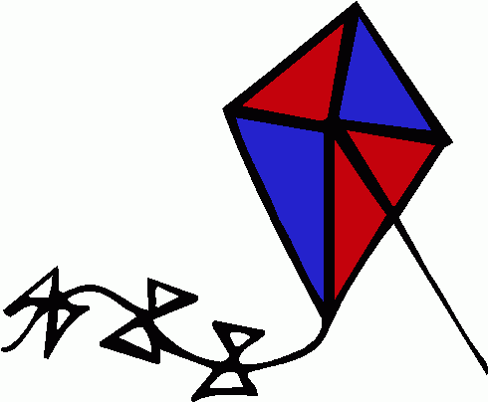
Big C, little c!
What begins with Cc?
Click on the right picture!

Slide 11
Big I, little i!
What begins with Ii?
Click on the right picture!

